Slide 1
Amazon Sales Data Analysis

Slide 2
Introduction
Sales management has gained importance to meet increasing competition and the need for improved methods of distribution to reduce cost and to increase profits. Sales management today is the most important function in a commercial and business enterprise.

Slide 3
Details of data
Columns
Region
Country
Item Type
Sales Channel
Order Priority
Order Date
Ship Date
Columns
Order ID
Total Cost
Units Sold
Unit Price
Unit Cost
Total Revenue
Total Profit
Descriptive
Data
Numerical Data
Dates

Slide 4
Main KPIs
Average Revenue
Average Cost
Average Profit
Total Units Sold

Slide 5
Mock – up Dashboard
Amazon sales Analysis
Filter by type
Filter by year
Filter by Region
Avg
Total
KPI
Profit

Slide 6
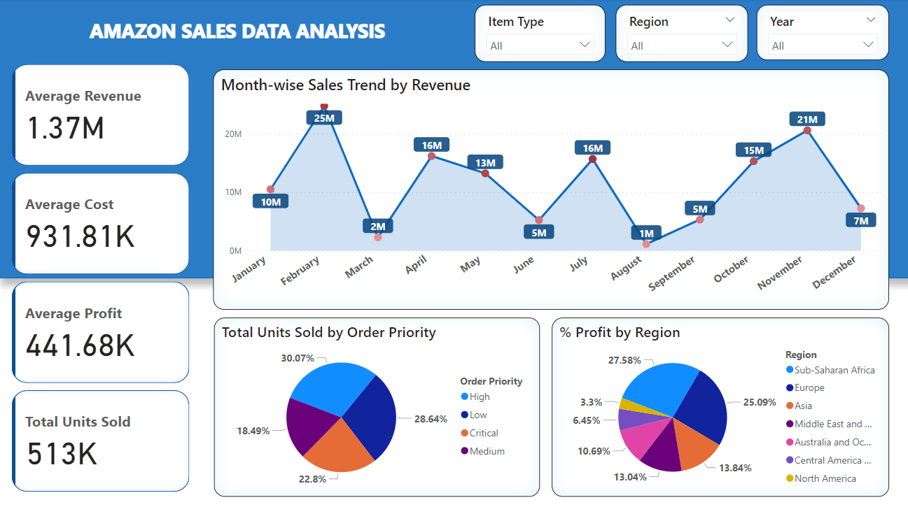
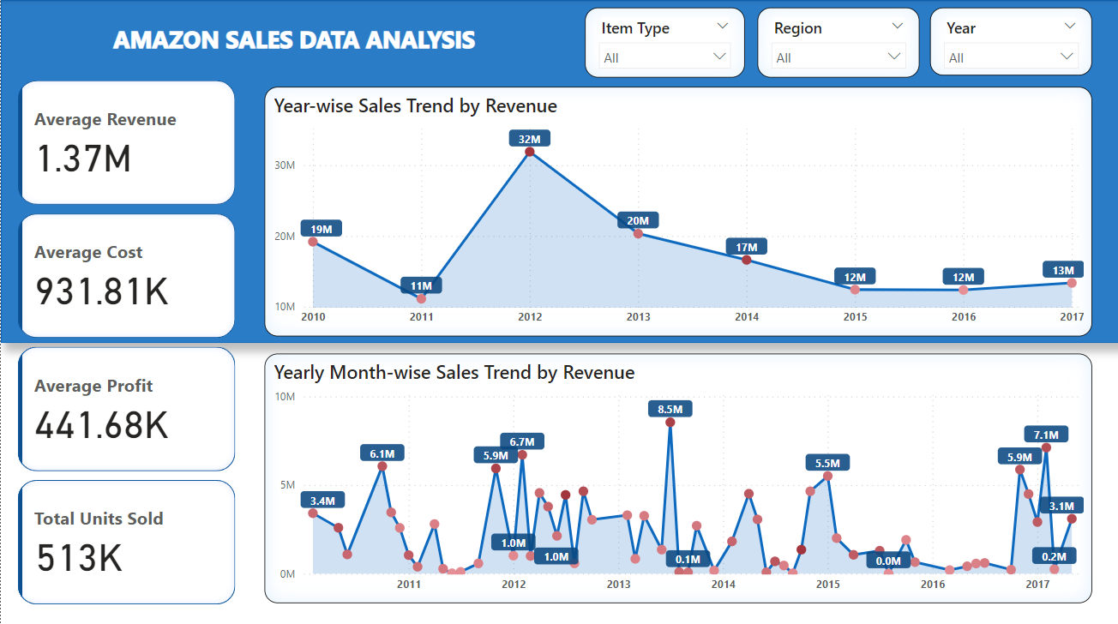
My Design

Slide 7
Thank You

